Slide 1
Revisiting Local History to Improve the Fused Two-Level Branch Predictor
Yasuo Ishii (The University of Tokyo, NEC)
Keisuke Kuroyanagi (The University of Tokyo)
Takeo Sawada (The University of Tokyo)
Mary Inaba (The University of Tokyo)
Kei Hiraki (The University of Tokyo)
Notes:
Good afternoon.
I’m Keisuke Kuroyanagi from the University of Tokyo.
Today, I’m going to talk about Revisiting Local History to Improve the Fused Two-Level Branch Predictor.

Slide 2
1. Revisiting local history
Exploring the best configuration of LHT for today's branch predictors.
Notes:
To design a new predictor, We first explored the best configuration of Local History Table for Today’s branch predictors.

Slide 3
Local History
A branch history series per branch address.
Many existing predictors employ local history
Large history table is required to provide a dedicated history for each branch instruction.
Effective in detecting control structures
Large storage cost and complexity
Notes:
Local History is a branch history series per branch address.
Many existing predictors employ local history because use of local history is an effective way to detect control structures, such as the loop structure.
However, branch predictors using local history have several problems.
First, a large history table is required to provide a dedicated history for each branch instruction.
Moreover, managing the local history table requires a complex mechanism.
So, the configuration of Local History has been restricted.

Slide 4
Local History Usage in CBP2
(2006, Realistic Track)
Proposer | Predictor Name | MPKI | Local History
 |  |  | # of entry | length
A.Seznec | L-TAGE | 2.926 | Unused
Y.Ishii | FTL | 2.976 | 1024 | 16
H.Gao and H.Zhou | PMPM | 2.988 | 1024 | 11
Y.Ninomiya and K.Abe | A³PBP | 3.458 | 4096 | 2
Recent predictors use conventional local history tables
L-TAGE (the victor) does not use local history
Notes:
This table shows what configurations of the Local History were used by CBP2 finalists.
Many recent predictors also use conventional Local History Tables which have a large number of entries and a short history.
L-TAGE is a characteristic predictor in this table.
L-TAGE was the victor but L-TAGE doesn’t use Local History.
This fact shows that predictors can give an accurate prediction without Local History.

Slide 5
Exploring the Design Space
Today, we can utilize a very long history.
Perceptron [D.Jiménez+ 01], Geometric history length [A.Seznec 05]
The design trade-offs for the local history may be changed.
Is there a more efficient configuration of LHT?
≒ Can FTL beat L-TAGE-like predictors??
Yes
No
Local history no longer plays a large role. Using only global history such as L-TAGE does is an efficient way.
Predictors using Local history can improve further prediction accuracy with such a LHT.
Notes:
Today, we can utilize very long histories by using perceptron or geometric history length.
So the design trade-offs for the local history may be changed.
Now, We have a big question about the Local History.
Is there a more efficient configuration of a Local History Table?
If the answer is Yes, predictors using Local History can improve further prediction accuracy with such a Local History Table.
However, If the answer is No, Local history no longer plays a large role. Using only global history such as L-TAGE does is a more efficient way, not only in terms of the cost, but also in terms of the accuracy.
After all, to put this question in other words: Can FTL beat the L-TAGE-like predictors?

Slide 6
Experiment
Explore the best configuration of LHT
We used a Fused Two-Level branch predictor (FTL) [Y.Ishii 07]
Change the configuration of LHT
Number of entries 4 - 4,096
History length 5 - 50
110 configurations are tested.
PC
BIM (Bimodal Table)
GHR
Global Components (Geometric HL)
Σ
Global Components (Geometric HL)
Prediction
Hash
Global Components (Geometric HL)
x10
LHT
Local Components (Geometric HL)
O-GEHL [A.Seznec 05]
Local Components (Geometric HL)
Hash
Local Components (Geometric HL)
FTL
x5
Notes:
To determine the answer to this question, We explored the best configuration of the Local History Table.
We used a fused Two-Level branch predictor.
This predictor is based on the O-GEHL branch predictor.
FTL extends the O-GEHL by using Local History.
We tested the configuration by changing FTL’s Local History Table.
The number of entries was tested within the range from 4 to 4096.
The history length was tested within the range from 5 to 50.

Slide 7
Results
Why?
32 entries are usually enough to provide nearly complete per-address history.
A mixed history is useful in accurate prediction
We don’t have a clear answer.
Large number of entries
Short history length
have been used
(a) Prediction accuracy of each configurations
(b) History length = 40
Is there a more efficient configuration of LHT?
(c) # of entries = 32/2,048
Yes!!
Moderate number of entries
Long history length
are an efficient configuration
Notes:
Now, I’d like to explain the results.
Chart A shows the MPKI of all configurations. The lower is better.
The blue line on Chart A corresponds to Chart B.
Chart B shows the MPKI when the history length is 40.
Surprisingly, all predictors using more than sixteen entries achieve the same accuracy range.
Especially, note that around 32 entries show a slightly higher prediction accuracy than a larger number of entries.
Why do around 32 entries show such high accuracy?
we don’t have a clear answer.
we guess that
Around 32 entries are usually enough to provide a nearly complete per-address history.
A mixed history is useful in accurate predictions.
The green line and the orange line on chart A correspond to Chart C.
Chart C shows the MPKI when the number of entries is 32 or 2048.
Using a Longer history than conventional configurations leads to more accurate predictions.
A Large number of entries and a Short history length have been used.
Such a configuration is indicated by the red circles on chart B and chart C.
However, this result shows that a Moderate number of entries and a Long history length are an efficient configuration.
So, The answer to this question is Yes.

Slide 8
Per-Set Branch History
Moderate number of entries is the most efficient.
The history using such table was called Per-Set branch history [T.Yeh+ 93].
Global
Local
FTL
Global
Per-Set
Local
Notes:
Now, I’d like to introduce the Per-Set Branch history.
We concluded that the local history table which employs a moderate number of entries is the most efficient.
The history using a moderate number of entries was called Per-Set branch history in a previous study.
The way to utilize the history has been improved.
Therefore, the history we should use also has been changed.
So, note that, FTL only uses the Global history and the conventional Local History.
However, we suggest that FTL with a Per-Set History would be a more accurate predictor.

Slide 9
2. FTL++
FTL branch predictor with per-set history and several optimizations
Notes:
I’m now going to introduce our proposed branch predictor FTL++.
FTL++ extends the FTL by includes Per-Set History and several optimizations

Slide 10
FTL++ Overview
BIM
Overwriting
PC
BIM
GHR
Global Components
Σ
Prediction
Hash
BC
Global Component
O-GEHL
PSHT
32
Per-Set Components
Hash
For Training
Whitelist filters
PSHT
8
Per-Set Components
Hash
Dynamic Threshold Fitting
Bias
Loop
LHT
Local Component
Blacklist filters
Hash
Give-up
Exceptional
FTL with Per-Set History
Filters
Filters
Notes:
FTL++ is based on the O-GEHL.
FTL++ uses the Global History, the Local History, and the Per-Set history.
FTL++ has a prediction overwriting mechanism named BIM Overwriting.
FTL++ also has some Filter predictors including two new filters.
In addition, We improved the Dynamic Threshold Fitting mechanism for deeply pipelined processors.

Slide 11
Histories and Components
4096-entry, 6-bit saturating counter
BIM
x1
Global History
297-bit
32-bit path
GHR
Global Components
Hash
x8
Global Component
x1
Directly indexed
by Global history
Per-Set History
32-entry, 69-bit
32-bit path
8-entry, 15-bit
15-bit path
PSHT
32
Per-Set Components
Hash
x6
PSHT
8
Per-Set Components
Hash
x2
Local History
1K-entry,3-bit
LHT
Local Component
x1
Hash
Notes:
FTL++ uses the Global History, the conventional Local History and 2 types of the Per-Set History.
One of the Per-Set History Tables has 32 entries and the other has 8 entries.
All components consist of 4K-entry 6-bit saturating counter tables.

Slide 12
BIM Overwriting
|sum| → confidence level. [V.Desmet 06]
Confidence level is low: BIM is often more accurate.
Check the confidence level
BIM
≧0?
≧0?
Σ
|Σ| < θ/2?
0 1
Overwrite
≧0?
BC
BIM Counter
Dynamic confidence level based on the accuracy of overwritten predictions
Prediction
Notes:
The absolute value of the sum from the adder tree shows the confidence level of the prediction.
If the confidence level is low, a simple predictor such as a Bimodal predictor is often more accurate than the base predictor.
So, The FTL++ employs a prediction overwriting mechanism which is named BIM Overwriting..
The BIM overwriting works as follows.
First, the confidence level is checked.
FTL++ uses two types of confidence levels.
One is the absolute value of the sum, and the other is the BIM Counter.
The BIM Counter shows the dynamic confidence level based on the accuracy of overwritten predictions.
Then, if the confidence level is low, the prediction from BIM is used instead of the prediction from the adder tree.

Slide 13
Filter Predictors
Prediction
Whitelist Filters
Filter easy-to-predict branches
Bias filter, Loop filter [H.Gao+ 05]
Blacklist Filters
Filter hard-to-predict branches
Give-up filter, Exceptional filter
Hit?
Whitelist filters
1 0
Bias
Loop
Filtered
prediction
Blacklist filters
Give-up
Exceptional
Filters
Easy
Hard
Whitelist
Filters
Blacklist
Filters
Main Predictor
Notes:
FTL++ has 4 filter predictors
We categorized these filter predictors as Whitelist filters or Blacklist filters .
Whitelist Filters are designed for filtering easy-to-predict branches.
FTL++ employ a bias filter and a loop filter as whitelist filters.
These were used in several previous studies.
On the other hand, Blacklist Filters are designed for filtering hard-to-predict branches.
We propose A Give-up filter and an exceptional filter as blacklist filters.

Slide 14
Blacklist Filters
Give-up filter
Accuracy of base predictor < Branch bias
Base predictor gives up predicting
e.g. A random branch will be filtered.
Exceptional filter
Prediction sum is far from correct
Occurs repeatedly → Stops training
Filters exceptional mispredictions.
Used only in the training phase
Notes:
The Give-up filter tracks a branch whose prediction accuracy of the base predictor is less than the bias of the branch.
The Base predictor gives up predicting and this filter predicts for such branches based on its bias.
For example, A random branch will be filtered.
This feature seams to be similar tothe Statistical Corrector Predictor of ISL-TAGE.
The Exceptional filter tracks a branch whose prediction sum is far from correct.
When the absolute value of the sum is large and the prediction is wrong, this filter starts tracking the branch.
If such a situation occurs repeatedly on the tracked branch, the predictor stops training.
This filter filters exceptional mispredictions.

Slide 15
Dynamic Threshold Fitting
The updating threshold θ is one of the most important parameters. [A.Seznec 05]
Dynamic Threshold Fitting
Derived from the O-GEHL
12-bit Threshold Counter (TC), θ = TC >> 6
misprediction → TC++ ,|sum| < θ → TC--
For deeply pipelined processors: misprediction →
Fetch stage
Retire stage
Σ
Σ
Prediction at retire
Circular buffer
Prediction at fetch
Prediction
If changed, increment TC once more.
Notes:
The updating threshold θ is one of the most important parameters.
The best value of this parameter differs depending on the workload.
So, we employed a Dynamic Threshold Fitting mechanism derived from the O-GEHL.
We improved the O-GEHL’s mechanism for deeply pipelined processers.
When a misprediction occurs, we compare the prediction at the fetch stage with the prediction at the retire stage.
If the prediction in the two stages has changed, we increment the Threshold Counter.

Slide 16
Other Optimization Techniques
History management for unconditional branches
Unconditional branch
Branch History
PC
(Global & Per-Set)
Path History
1-bit on INDR,2-bit on RET/OTHER, 3-bit on CALL
The behavior of branches after CALLs and RETs has little correlation to prior branches. [L.Porter+ 09] [G.Loh 05]
Special treatment for Kernel space
Global
Kernel/user histories [A.Seznec]
Per-Set
If in the kernel space, use limited entries (8, 32 → 4) for putting or reading history
Notes:
FTL++ also includes some other optimization techniques.
One is a history management for unconditional branches. When an unconditional branch is encountered, append a bit from the pc to the branch history instead of treating it as a taken branch.
We append multiple bits to histories on some types of branches.
2 bits on Returns and Others, and 3bits on Calls
Another technique is a special treatment of Kernel space.
For Global History, FTL++ uses Kernel/user histories that were proposed in a previous study.
For Per-Set History, FTL++ uses a Limited number of entries of History tables.

Slide 17
Scores on CBP3 traces
Trace | MPPKI |  |  | MPKI
 | FTL | FTL++ | Δ | FTL | FTL++ | Δ
CLIENT02 | 2663.7 | 2082.4 | 27.9% | 18.20 | 14.25 | 27.7%
INT05 | 292.24 | 260.15 | 12.3% | 3.201 | 2.797 | 14.4%
WS01 | 371.39 | 357.21 | 4.0% | 2.763 | 2.653 | 4.1%
Average | - | - | 6.2% | - | - | 6.9%
Improves the FTL‘s accuracy for 38 out of 40 traces.
6% more accurate than 65KB FTL on average.
Notes:
This table shows some examples of the prediction accuracy.
FTL++ improves the FTL’s accuracy for 38 traces.
FTL++ is around 6% more accurate than FTL on average.

Slide 18
Conclusion
We revisited the local history
Using a Moderate number of entries and long history length is useful in making accurate predictions.
We proposed the FTL++ predictor
Per-Set History
Dynamic Threshold Fitting
BIM Overwriting
Blacklist filtering
Other Optimization Techniques
Notes:
In Conclusion.
We, first, revisited the local history.
From the preliminary experiment, we found that using a Moderate number of entries and a long history length is useful in making accurate predictions.
We then proposed the FTL++ branch predictor.
The FTL++ uses a Per-Set History which we found in the Revisitation.
This also employs several optimizations.
Our research shows the FTL++ achieves very high prediction accuracy.
Thank you for listening.
Are there any questions?

Slide 19
Reference
CBP2, The 2nd JILP Championship Branch Prediction Competition (http://cava.cs.utsa.edu/camino/cbp2/)
T.-Y. Yeh and Y. N. Patt, “A comparison of dynamic branch predictors that use two levels of branch history,” in Proceedings of the 20th Annual International Symposium on Computer Architecture, ISCA ’93, pp. 257–266, 1993.
Y. Ishii, “Fused two-level branch prediction with ahead calculation,” The Journal of Instruction Level Parallelism, vol. 9, May 2007.
A. Seznec, “Analysis of the o-geometric history length branch predictor,” in Proceedings of the 32nd annual international symposium on Computer Architecture, ISCA ’05, pp. 394–405, 2005.
L. Porter and D. M. Tullsen, “Creating artificial global history to improve branch prediction accuracy,” in Proceedings of the 23rd international conference on Supercomputing, ICS ’09, pp. 266–275, 2009.

Slide 20
Reference
D. A. Jimenez and C. Lin, “Dynamic branch prediction with perceptrons,” in Proceedings of the 7th International Symposium on High-Performance Computer Architecture, HPCA ’01, pp. 197–206, 2001.
V. Desmet, L. Eeckhout, and K. De Bosschere, “Improved composite confidence mechanisms for a perceptron branch predictor,” J. Syst. Archit., vol. 52, pp. 143–151, March 2006.
H. Gao and H. Zhou, “Adaptive information processing: An effective way to improve perceptron predictors,” The Journal of Instruction Level Parallelism, vol. 7, April 2005.
Gabriel H. Loh, “Deconstructing the Frankenpredictor for Implementable Branch Predictors,” The Journal of Instruction Level Parallelism, vol. 7, April 2005.

Slide 21
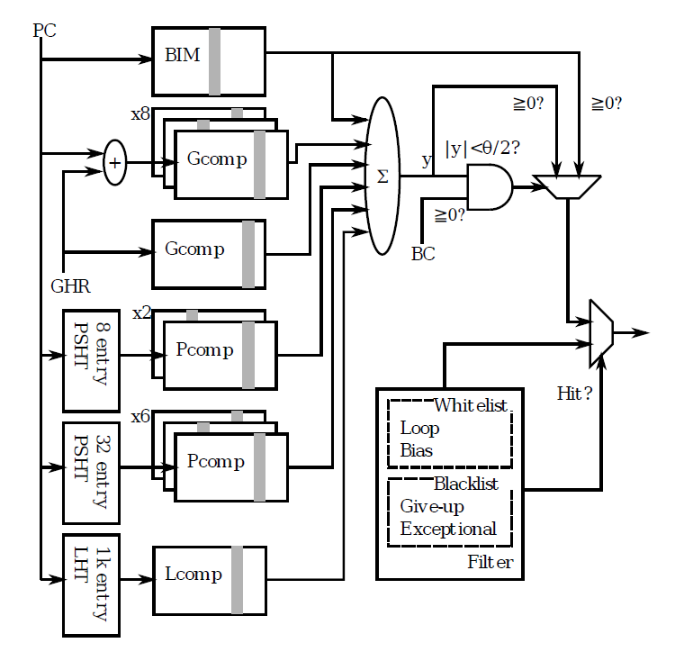
BIM overwriting
GEHL
Per-Set
History
FTL++
overview
new filters

Slide 22
2

