Slide 1

Perceptron Branch Prediction with Separated T/NT Weight Tables
Guangyu Shi and Mikko Lipasti
University of Wisconsin-Madison
June 4, 2011

Slide 2
Perceptron Branch Prediction
Perceptron branch predictor [Jiménez & Lin, 2001]
7 4 -8 -3 -5
6 5 -9 -2 -4
3
Y
PC
-2
N
*
>=0
Taken
Not-taken
History
1 -1 1 -1 -1
Outcome: Not-taken

Slide 3
Intuition
A code example:
To predict branch B:
  If A is taken, B is also taken for sure
  If A is not taken, do not know the outcome of B
If A is taken at certain frequency, then whenever A is not-taken, B will be predicted “not-taken”.
… // x is an unknown value
if (x>1000) // Branch A
{ /* do something …*/}
if (x>500) // Branch B
{ /* do something else… */}

Slide 4
Intuition
Perceptrons can represent positive or negative correlations between branch B and past branches.
They cannot strengthen 1(2) without strengthen 4(3), or vice versa
T
NT
… // x is an unknown value
if (x>1000) // Branch A
{ /* do something …*/}
if (x>500) // Branch B
{ /* do something else… */}
2
3
1
4
T
NT

Slide 5
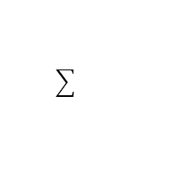
SWP: Separated Weight Predictor
Separate T/NT weight tables
Prediction Algorithm:
function predict: boolean
begin
sum := 0;
index := hash (PC);
for i in 1 to ghl do
if GHR[i] = true then
sum := sum + WT[index, i];
else
sum := sum + WNT[index, i];
end for
predict := (sum>=0);
end
1
0
1
1
0
WT
WNT

Slide 6
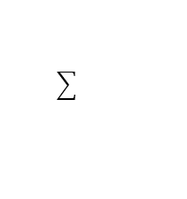
SWP: Separated Weight Predictor
Update Algorithm
function update begin
if |sum|<threshold or predict != br_taken
index := hash (PC);
for i in 1..ghl do
if {GHR[i] , br_taken} = {1, 1} then
WT[index,i] := WT[index,i] +1;
if {GHR[i] , br_taken} = {1, 0} then
WT[index,i] := WT[index,i] -1;
if {GHR[i] , br_taken} = {0, 1} then
WNT[index,i] := WNT[index,i] +1;
if {GHR[i] , br_taken} = {0, 0} then
WNT[index,i] := WNT[index,i] -1;
end for
end if
end
1
0
1
1
0
WT
WNT

Slide 7
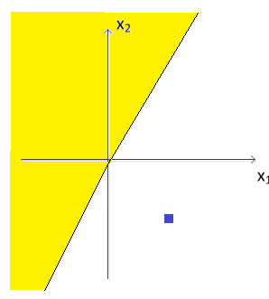
SWP: Separated Weight Predictor
History
1 -1(0)
Perceptron
-3 -1
Prediction: -3 – (-1) = -2 Not-taken
Capable of prediction some linearly inseparable branches even if path information is the same

Slide 8
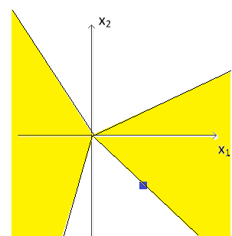
SWP: Separated Weight Predictor
Capable of prediction some linearly inseparable branches even if path information is the same
History
1 -1(0)
1 -2
SWP
4 -1
Prediction: 1+(-1) = 0 (Taken)

Slide 9
SWP: Separated Weight Predictor
Combined with other optimization schemes
  Piecewise linear branch prediction [Jiménez, 2005]
  Dynamic threshold from O-GEHL [Seznec, 2005]
Bias weights are removed

Slide 10
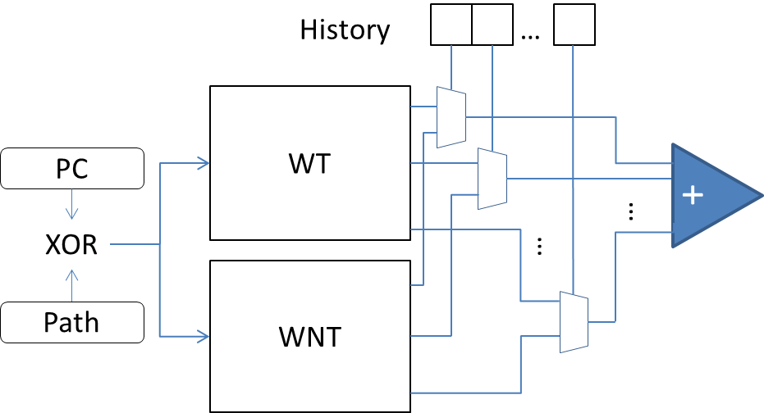
Implementation of SWP
Additional multiplexors (in parallel)
No bitwise complement of weights needed

Slide 11
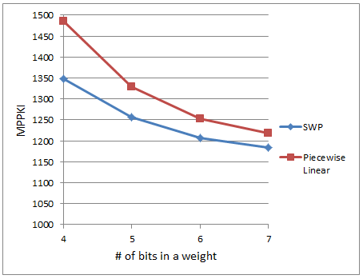
Simulation Result
Performance result of 11 traces out of 40 (in MPPKI)

Slide 12
Optimization for space
Space inefficient: 2x storage space of the regular perceptron predictor.
Solution: Partially separated weight tables
History 1 to h0
1 0 0 1 … 0
History h0+1 to h
*
WT
1 1 -1 1 … -1
PC
*
W
XOR
WNT
Path
*
0 1 1 0 … 1

Slide 13
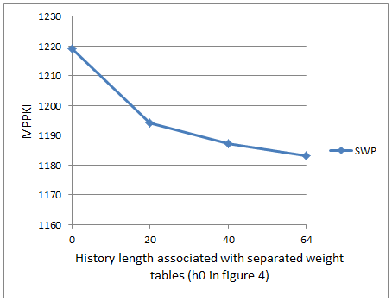
Optimization for space
Simulation result on branch prediction with partially separated weight tables (in MPPKI)

Slide 14
Configuration for CBP-3
Final configuration: 3 different weight tables
  First 20 branches: separated weights, 1024 entries
  Next 16 branches: single weight, 1024 entries
  Last 29 branches: single weight, 512 entries
  Total history length: 65
  Total size of the weight tables: 61.7KB

Slide 15
Future work
Analyze how often is code example 1 executed
Further reduce the storage budget by using adaptive encoding algorithm

