Slide 1
The 1st JILP Data Prefetching Championship (DPC-1) Enhancement for Accurate Stream Prefetching
Gang Liu¹, Zhuo Huang¹, Jih-Kwon Peir¹, Xudong Shi², Lu Peng³
1. University of Florida
2. Google Inc
3. Louisiana State University

Slide 2
Outline
Introduction
Enhancement techniques
Integrating stride prefetching
Stream repetition
Noise removal
Dead stream removal
Performance Evaluation

Slide 3
Background
Data prefetching
Miss address regularity
Stride
Stream
Distance
Miss address correlation
Correlation
Markov
Hot Stream

Slide 4
Stream Prefetcher
Training a Stream:
3 consecutive block misses in a small region (16 blocks) in the same direction
miss sequence
100
102
104
503
504
501
499
100
102
104
503
504
504
501
Trained!
501
499
Fail!
Trained!
1st miss
2nd miss
3rd miss
1st miss
2nd miss
3rd miss

Slide 5
Stream Prefetcher
Prefetching:
Stream direction
memory access
start addr
end addr
Monitored region
original addr
prefetch distance
prefetch degree

Slide 6
Enhance #1 – integrating stride prefetching
Constant stride (from Art)
Example: Code segment from Art
Memory Allocation:
for (i=0;i<numf1s;i++)
{ //numf1s = 10000,numf2s = 11
bus[i] = (double *)malloc(numf2s*sizeof(double));
tds[i] = (double *)malloc(numf2s*sizeof(double)); }
Regular stream prefetches: …100,101,102,103,104,105…
&bus[i+1][j] - &bus[i][j] = 192 bytes
Memory Access:
for (tj=0;tj<numf2s;tj++) {
Y[tj].y = 0;
if ( !Y[tj].reset )
for (ti=0;ti<numf1s;ti++)
Y[tj].y += f1_layer[ti].P * bus[ti][tj];
}
&bus[i][j] → &bus[i+1][j] = 3 blocks

Slide 7
Enhance #1 – integrating stride prefetching
Stream w/ stride
Stream direction
memory access
start addr
end addr
Monitored region
original addr
prefetch degree * stride
prefetch distance * stride

Slide 8
Enhance #2 – stream repetition
Early prefeching of repeated streams
memory access
Memory Access:
for (tj=0;tj<numf2s;tj++) {
Y[tj].y = 0;
if ( !Y[tj].reset )
for (ti=0;ti<numf1s;ti++)
Y[tj].y += f1_layer[ti].P * bus[ti][tj];
}
Stream direction
Repeated stream: separated by a few instructions
start addr
end addr
Monitored region
Monitored region
original addr
prefetch distance
prefetch degree

Slide 9
Enhance #3 – noise removal
Special noise prevents stream being trained
missed block sequence:
106,107,104,105,102,103
106
107
104
105
102
103
106
107
107
104
104
105
106
107
104
107
104
105
102
105
Succeed!
Fail!
1st miss
2nd miss
3rd miss
1st miss
2nd miss
3rd miss
Ignore noise
Ignore noise
Regular Training
Training w/ noise removal

Slide 10
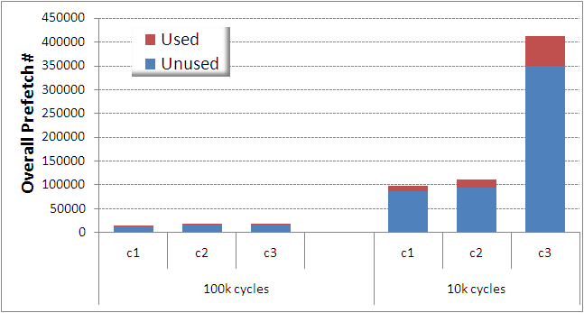
Enhance #4 – dead stream removal
Dead stream
Inactive for a long time (10k/100k cycles)
Stream is short (<128 blocks)
Dead-streams’ first prefetching
Stream table size = 128
85% unused

Slide 11
Performance Evaluation
Evaluation
12 high MPKI SPEC2000/SPEC 2006 benchmarks
CMPsim, 3 configurations (c1, c2, c3)
L2 prefetching only
Prefetcher | Configuration | Size
GHB-distance | 256 IT entries, 256 GHB entries, prefetch width/depth = 16/16 | 4KB
Stream | 8 combined entries, prefetch distance/degree = 64/4 | 64B
Enhance-Stream | 8 stream entries, 16 training entries, prefetch distance/degree = 64/4 | 256B

Slide 12
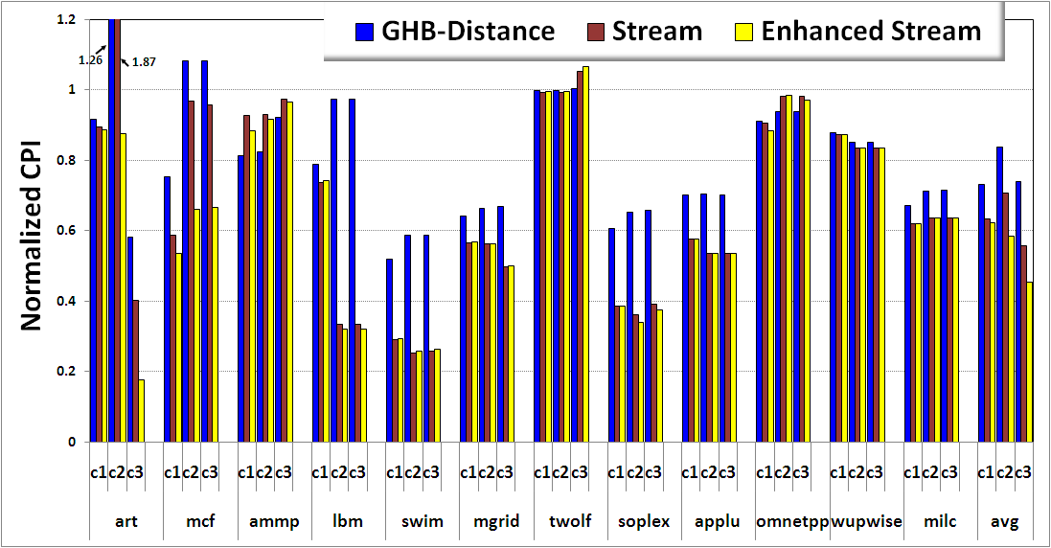
CPI Comparison
Stride prefetching
46.4%
1.9
1.7
1.2
Improvement over no prefetching
3.4
23.2%
37.6%
2.3
1.0
art
soplex
C3: 5. 5%
Noise removal
Stream repetition
Stream vs Enhanced Stream
about 1%
C1: 1.8%
C2: 17.6%
C3: 18.7%

Slide 13
Sensitivity on stream table size
Best case: 8/16

Slide 14
Effect of dead stream removal
In size 16, Swim 5% better than size 8

Slide 15
Conclusion
37.6%, 41.6%, and 54.5% better than no prefetching for c1, c2, c3 respectively.
1.8%, 17.6%, and 18.7% better than original stream prefetcher.
hardware overhead is very little.

