Slide 1
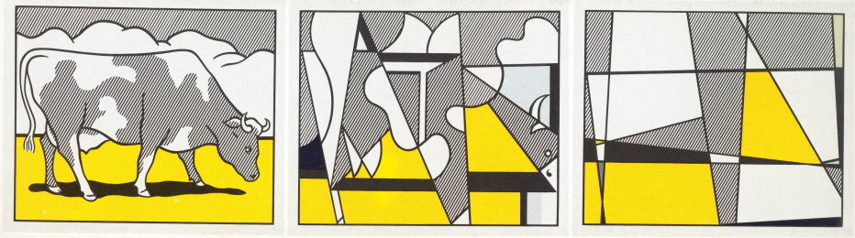
Bias-Free Neural Predictor
Dibakar Gope and Mikko H. Lipasti
University of Wisconsin – Madison
Championship Branch Prediction 2014

Slide 2

Executive Summary
Problem:
Neural predictors show high accuracy
64KB restrict correlations to ~256 branches
Longer history still useful (TAGE showed that)
Bigger h/w increases power & training cost!
Goal: +
Our Solution:
Filter useless context out
Large History
Limited H/W
Notes:
Here in this work, we propose BFN predictor that attempts to learn distant branch correlations by capturing only useful information in a branch predictor’s history.

Slide 3
Key Terms
Biased– Resolve as T/NT virtually every time
Non-Biased– Resolve in both directions
Let’s see an example …

Slide 4
Motivating Example
A
Non-Biased
B, C & D provide
No
additional information
Biased
B
C
Biased
D
Biased
Left-Path
Right-Path
E
Non-Biased
Notes:
the change in the direction of the Branch A provides
sufficient evidence to cause a change in the direction of the
Branch E. In other words, the control flow through either the
Branch B or the Branches C and D in the two program paths
merely reinforces the prediction decision of the Branch E that
can independently be established by correlating only with the
non-biased branch A.

Slide 5
Takeaway
NOT all branches provide useful context
Biased branches resolve as T/NT every time
  Contribute NO useful information
  Existing predictors include them!
Branches w/ No useful context can be omitted

Slide 6
Biased Branches
Notes:
This figure demonstrates the sizable presence of biased branches in the given traces. In other words it confirms the substantial presence of redundant information in a branch predictor’s history.

Slide 7
Bias-Free Neural Predictor
Conventional Weight Table
GHR:
…..
BFN
Weight Table
BF-GHR:
…..
Filter Biased Branches
Recency-Stack-like GHR
One-Dim.
Weight Table
Positional History
Folded Path History

Slide 8
Idea 1: Filtering Biased Branches
Biased: B
Non-Biased: NB
NB B B NB B NB NB
A X Y B Z B C
Unfiltered GHR:
1 0 1 0 0 1 0
A B B C
Bias-Free GHR:
1 0 1 0

Slide 9
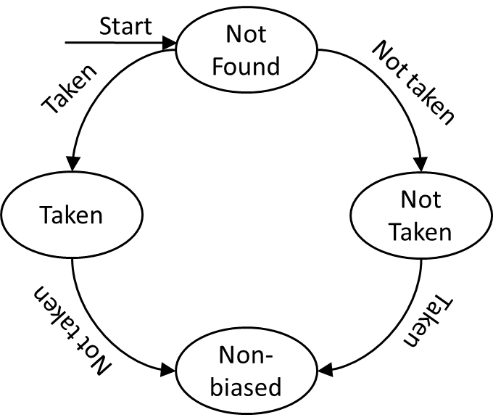
Idea 1: Biased Branch Detection
All branches begin being considered as biased
Branch Status Table (BST)
  Direct-mapped
  Tracks status
Notes:
Probabilistic Updates/partial tags
The BFN predictor implements a direct-mapped structure BST to maintain those FSMs and classify the branches as biased or non-biased.

Slide 10
Idea 2: Filtering Recurring Instances (I)
Non-Biased:
A B B C A C B
Unfiltered GHR:
1 0 1 0 0 1 0
A B C
Bias-Free GHR:
1 0 0
Minimize footprint of a branch in the history
Assists in reaching very deep into the history

Slide 11






Idea 2: Filtering Recurring Instances (II)
$${PC}_{x}$$
$${PC}_{y}$$
$${PC}_{z}$$
$${PC}_{nb}$$
=?
=?
=?
$$h_{in}$$
D
Q
D
Q
D
Q
D
Q
$${CLK}_{}$$
Recency stack tracks most recent occurrence
Replace traditional GHR-like shift register

Slide 12
Re-learning Correlations
Unfiltered GHR:
A X B C
A X B C
Bias-Free GHR:
A
B
C
A
X
B
C
1
2
3
X Detected Non-biased
1
3
4
Hash Func.
Table
Index

Slide 13
Idea 3: One-Dimensional Weight Table
Unfiltered GHR:
A X B C
A X B C
Bias-Free GHR:
A
B
C
A
X
B
C
X Detected Non-biased
Hash Func.
Table
Index
Branches Do NOT depend on relative depths in BF-GHR
Use absolute depths to index

Slide 14
Idea 4: Positional History
if (Some Condition) / / Branch A
array [ 10 ] = 1;
for ( i = 0 ; i < 100 ; i ++) / / Branch L
{
if ( array [ i ] == 1 ) { ..... } / / Branch X
}
Recency-stack-like GHR capture same history across all instances
  Aliasing
Positional history solves that!
Only
One instance of X correlates w/ A

Slide 15
Idea 5: Folded Path History
A influences B differently
  If path changes from
  M-N to X-Y
Folded history solves that
  Reduce aliasing on recent histories
  Prevent collecting noise from distant histories
Path A-M-N
A
M
N
B
A
X
Y
Path A-X-Y

Slide 16
Conventional Perceptron Component
Some branches have
  Strong bias towards one direction
  No correlations at remote histories
Problem: BF-GHR can not outweigh bias weight during training
Solution: No filtering for few recent history bits

Slide 17
BFN Configuration (32KB)
Unfiltered
Bias-Free
GHR:
A
B
C
X
Y
Z
Loop Pred.
Hash Func.
Table
Index
1-dim weight table
2-dim weight table
+
Unfiltered: recent 11 bits
Bias-Free: 36 bits
Is Loop?
Prediction

Slide 18
Contributions of Optimizations
3 Optimizations : 1-dim weight table + phist + fhist
BFN (3 Optimizations) MPKI: 3.01
BFN (ghist bias-free + 3 Optimizations) MPKI: 2.88
BFN (ghist bias-free + RS+ 3 Optimizations) MPKI: 2.73

Slide 19
Conclusion
Correlate only w/ non-biased branches
Recency-Stack-like policy for GHR
3 Optimizations
  one-dim weight table
  positional history
  folded path history
47 bits to reach very deep into the history

