Slide 1
4th JILP Workshop on Computer Architecture Competitions Championship Branch Prediction (CBP-4)
-Moinuddin Qureshi (GT)

Slide 2
Why Another CBP?
Branch prediction remains an important problem for architecting high performance processors
One of the few optimizations that can:
Improve single-threaded performance
Improve energy efficiency
Be implemented in a localized manner (small change)
Previous CBP happened in 2011, time to rescan for new ideas

Slide 3
Thanks
Organizing Committee
Moin Qureshi, GT (chair)
Alaa Alameldeen, Intel
Chris Wilkerson, Intel
Aamer Jaleel, Intel
Program Committee
Moin Qureshi, GT (chair)
Trey Cain, Qualcomm
Hyesoon Kim, GT
Gabe Loh, AMD
Pierre Michaud, INRIA
Jared Stark, Intel
+Org Committee
Special thanks to: Aseem Grover (GT,Apple) for handling submission/evaluations

Slide 4
Format of CBP
Three tracks
A 4KB track (for small systems)
A 32KB track (for large systems)
Unlimited track (let’s get the limit)
Workloads: 40 traces
20 short (30 mln) from CBP-1 [INT, FP, SRV, MM]
20 long (150 mln) from SPEC2006
Figure of merit:
Mispredictions per 1000 insts (MPKI)
Arithmetic mean of MPKI over all 40 traces

Slide 5
Submissions and Acceptance
Total 12 papers submitted
6 for the 4KB category
6 for the 32KB category
11 for unlimited track
Total 10 papers accepted
5 for the 4KB category
6 for the 32KB category
10 for unlimited track
Countries represented: USA, Canada, France, Japan, India

Slide 6
Process
Requirements:
Code and paper should be readable
Design must not violate causality (cannot use future information to predict the current branch).
Reviews:
2 to 3 reviews per paper
- Offline program committee meeting
Papers selected primarily on MPKI (and/or new ideas)
Note: Authors of accepted papers were allowed to modify their design till camera ready deadline
We will use only the revised code for ranking

Slide 7
Fixed Traces ➔ Address Memoization
Using same set of traces for both submission and evaluation can get misused easily
E.g. How to get MPKI=0 for unlimited sized predictors
PC Address in Trace | Record Outcome History, Store in Table
0xDEADBEEF | 1,0,1,1,0,0,1,0,1,0 ….
0xFADEDACE | 1,1,1,1,0,0,0,1,0,1 ….
0xCAFEBABE | 1,0,1,0,1,0,1,1,0,0 ….
A table stores the outcome of each PC during design time
Prediction: access this table & keep track of access counts
To keep the contest meaningful, our evaluation infrastructure must be robust against such address memoization

Slide 8
Address Space Shifting to Avoid Memoization
Shift the address space by constant “Base” ➔ Changes all PC
PC’ = PC + Base
Target’ = Target + Base
Program
Virtual Address Space
We use address space shifting for all tracks
Our evaluated MPKI may be (is) different from the author’s
So, stay tuned till the end to know the winner(s)

Slide 9
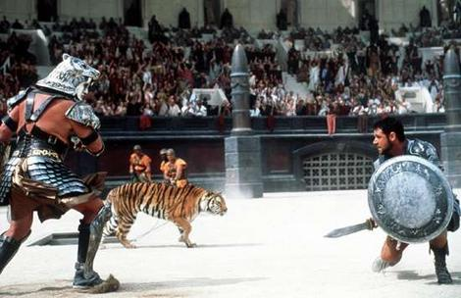
Let the Championship Begin …

